Slide 1

Solent Prosperity Fund - Overview
Kate Cloud
7 November 2019

Slide 2

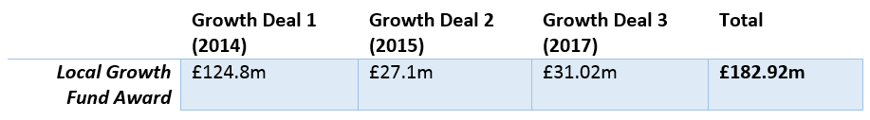
Setting the Context
Solent Local Enterprise Partnership covers Isle of Wight, New Forest, Southampton, Eastleigh, Fareham, Gosport, Portsmouth and Havant local authority areas
Local Enterprise Partnerships focus on enhancing productivity across their economies, through the development and delivery of Local Industrial Strategies.
Solent LEP has agreed three Local Growth Deals with Government, securing £182.92m of capital funding.
Much of this is either spent or allocated, but we need to build our pipeline to ensure we spend all funding and in readiness for new funding.
Solent Prosperity Fund allocated specifically for SMEs
Grant funding needs to be spent by 31st March 2021, and Loan funding by 31st March 2022.

Slide 3

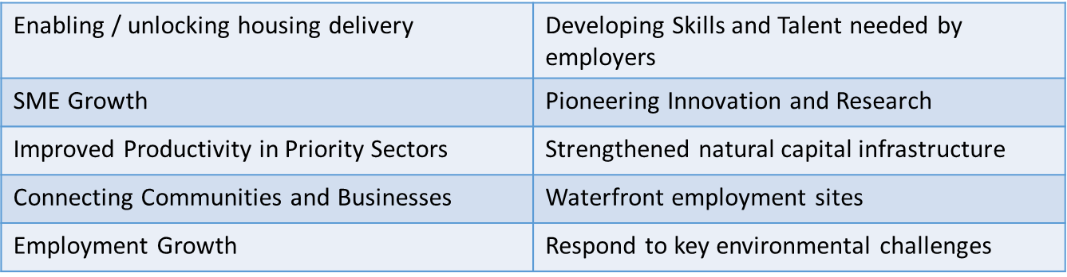
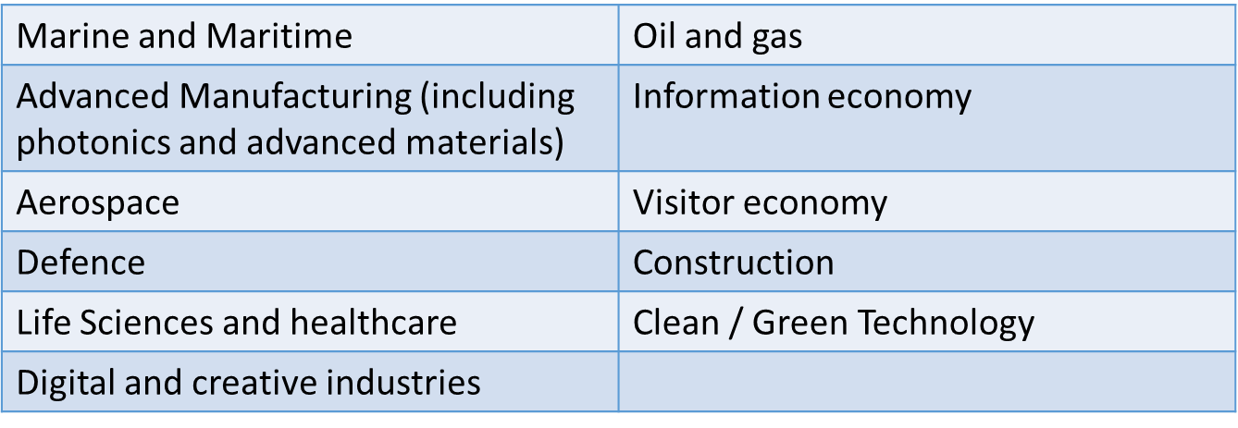
Fund Overview: Outputs and Sectors
Outputs:
Sectors:

Slide 4

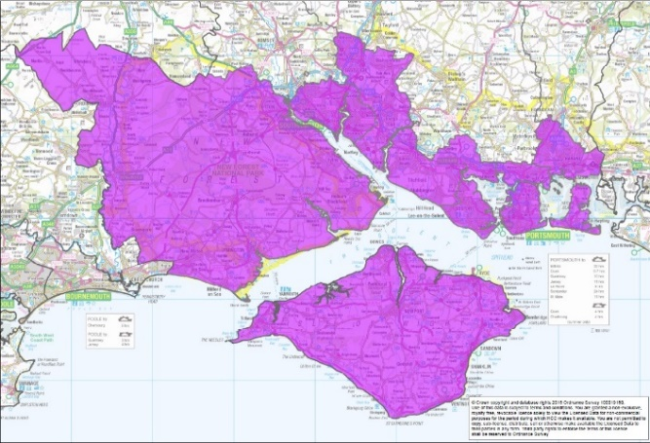
What support is available?
Large projects
Large programmes
High growth start up
Existing SMEs
Growth Accelerator Programme
Solent Growth Hub
Enterprise Advisor Network

Slide 5

Key Information: Large Projects & Programmes
For large scale projects
Capital Investment only - start by June 2020
Funding requests from £500,000 to £5 million
Enabling/unlocking housing delivery, SME growth, productivity, digital connectivity, transport/infrastructure, employment growth, developing skills & talent, pioneering innovation & research, strengthened Natural Capital Infrastructure, waterfront employment sites, responses to key environmental challenges, low carbon energy innovations
Funding: Grants, loans or equity investment
For private sector projects, a maximum contribution of 20% can be made available (subject to state aid)
How to start? Complete the enquiry form online.

Slide 6

Key Information: High Growth Start Ups
Show detailed business forecasts and projections of turnover or employment growth of 20% for the next 3 years
Capital for investment in new products, processes or services, and/or developing new markets
Grants from £5,000 to £100,000
Funding can provide up to 50% of total project costs
‘Start-Up’ - registered with Companies House for less than 2 years, and NOT TRADING at time of submission
Project must be delivered within the Solent LEP area
How to start? Complete the enquiry form online.

Slide 7
Key Information: SME Expansion
SME Expansion Fund: Helping SMEs with ambitions to scale up, expand and grow, resulting in creation of private sector jobs
SME Support Fund: Changing trading conditions arising from BREXIT, consolidation of operations, broadening of market reach, diversification, challenges for retail and the high street, relocation of businesses.
Apply for up to 30% of your total project cost, from £5,000 to £100,000
Projects must be delivered within the Solent LEP area
Applications must show three years of accounts plus detailed business forecasts and projections of turnover or employment growth for the next 3 years
How to start? Complete the enquiry form online.

Slide 8

Key Information: Growth Accelerator Programme
Working in partnership with leading accountants and business advisers, BDO.
If you qualify for this free service, you will receive 12 hours of one-to-one support that will focus purely on your business and where you want to take it.
Discuss and explore opportunities eg securing finance, unlocking new markets, staffing, innovation, customer retention.
It will be facilitated by an expert growth coach.
Whatever your ambition is, the Growth Accelerator Programme will help you to create a growth action plan to take your business to that next stage.
How to start? Complete the enquiry form online.

Slide 9

Solent Growth Hub
Telephone support service provides a comprehensive range of assistance, simplifying the process of accessing support and enabling businesses to grow and develop within the region.
Business clinics, giving opportunities to discuss barriers to growth with a business advisor.
Expert guidance in LEP funding applications, assessing suitability, identifying opportunities for support, providing pre-submission support on applications, basic sense-checking.
Growth Accelerator Programme providing 12 hours of dedicated resource to established SME`s with ambition to improve productivity, develop new products and/or markets and create jobs.
Masterclasses in a range of topics which help small business owners build their knowledge and networks e.g. Exporting, Customer Engagement, Leadership
Contact the Solent Growth Hub on 02392 688055 or email enquiries@solentlep.org.uk

Slide 10


Enterprise Advisor Network
Could you be an Enterprise Adviser?
A unique opportunity to support a local school or college to build effective employer networks.
They work closely with a school or college Careers Leader, helping them to develop a strategic and sustainable plan to engage with business. They are supported by a team of Enterprise Coordinators and a range of resources, tools and information.
Why this is important?
The aim is to increase the number of encounters and experiences young people have with the world of work. Businesses have valuable expertise to share in finding effective ways to do this, connecting the classroom to the workplace.
Benefits to you
Gain insight into the education sector
Directly interact with the talent pool in the local area
Contribute to your Corporate Social Responsibility policy
Build a wider business network
Access professional development opportunities

Slide 11
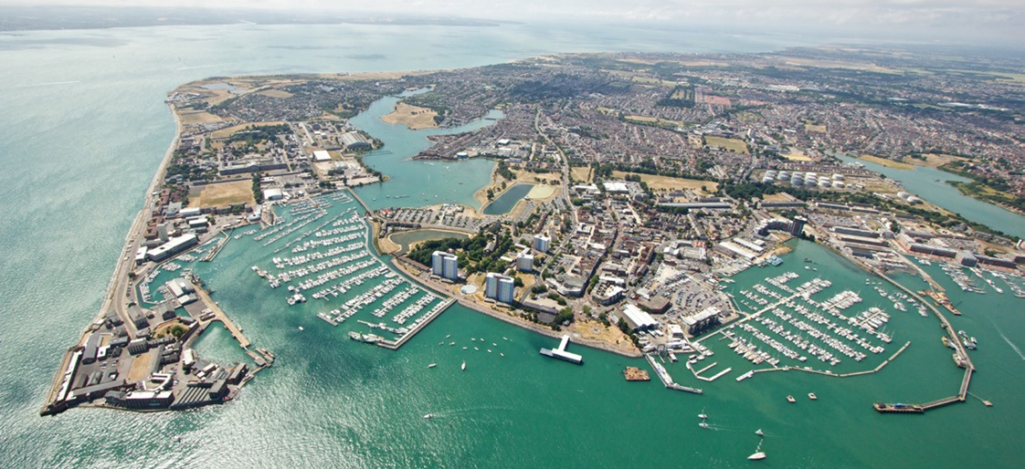
Questions?

